Slide 1
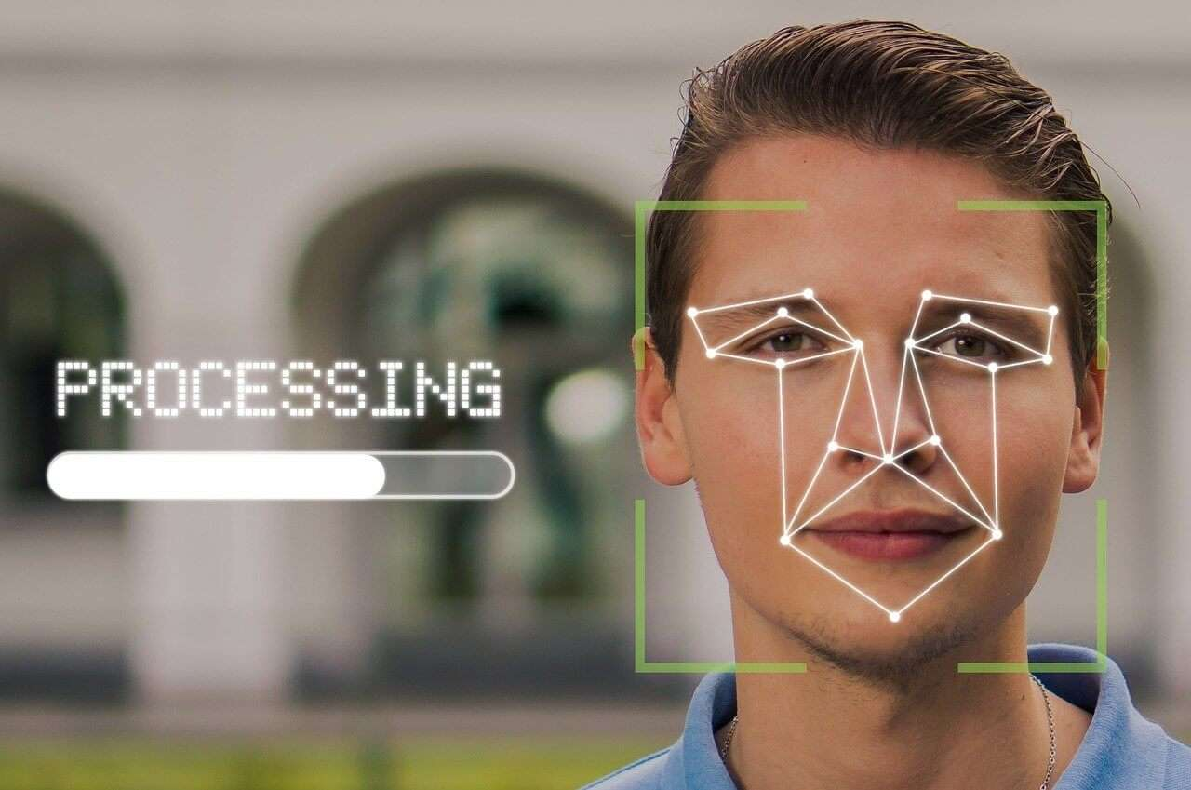
The Rise of Artificial Intelligence &
Facial Recognition
Team 53
Ayush Pagaria
Jamelia Gordon
Zixiao Xu
Xinyi Zhou

Slide 2
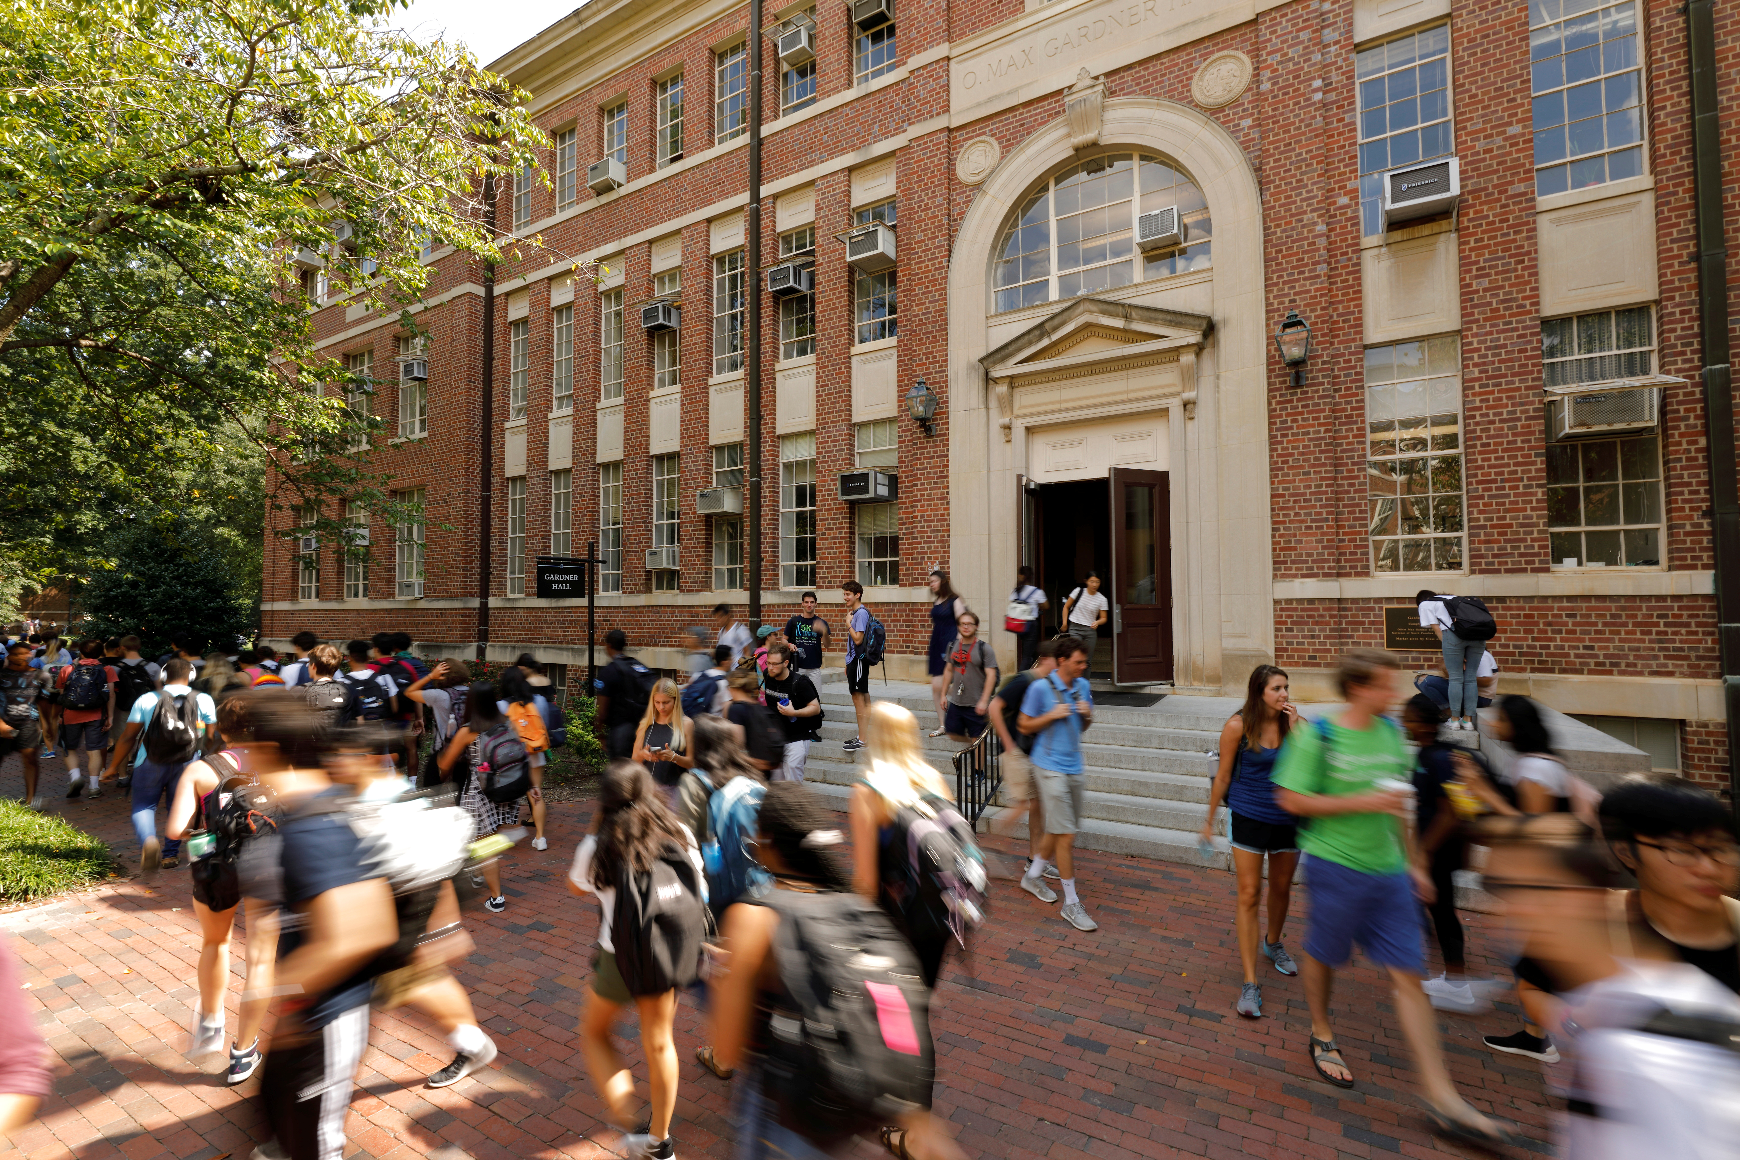

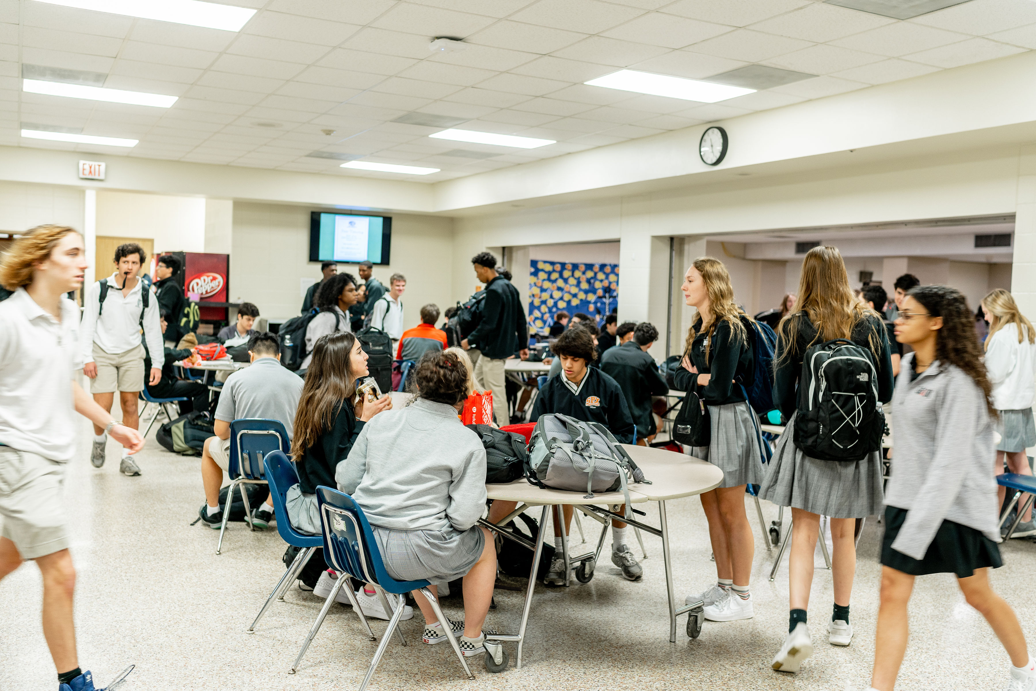
How Safe are Schools?
Based on the Annual Schooling in America Survey:
~77% American Parents are worried about violent intrusion
~47% of American Parents feel that their district schools can handle gun violence
While choosing their child’s school, a ‘safe environment’ was the top response by American Parents

Slide 3




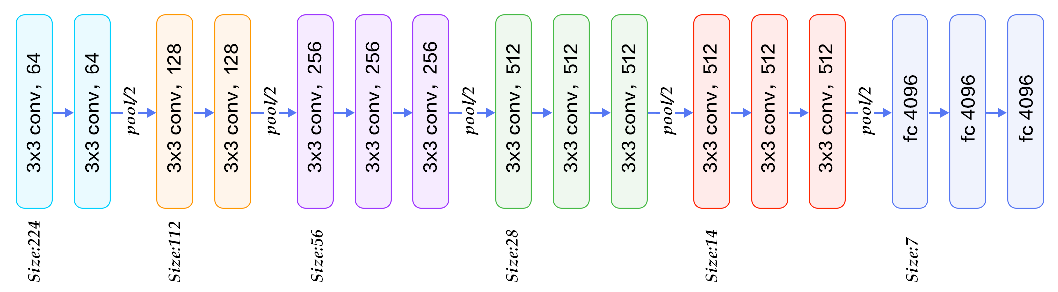

Data Preparation
Procedure:
MetaData: Dataset with Images and Corresponding Labels Merged into a Single Dataset
Multiple Images: 18 Identities with Multiple Images
Transformed Images: Normalized Pixel Values and Centre-Cropped Images to ensure size consistency
Generated Facial Embeddings using VGG Face Model, a unique feature of the VGG Model
Dataset
(100%)
(90%)
Testing
(10%)
Training
(10%)
Validation
(90%)
Split Data into Training, Testing & Validation

Slide 4
Modeling
Baseline Model
Optimization Model
Logistic Regression Model & ‘nn.sequential’ used to build a neural network to transform the inputs to 1064 dimensions
ReLu Activation Layer & Softmax function contributes to the probability output
Cross-entropy loss function as it assigns a higher penalty to predictions and provide better gradient performances
Adam Optimizer defined to update the model’s parameters
Learning Rate set to 0.001 with 100 epochs
Softmax Classifier Model, built with 3 fully connected layers
Three hidden layers enhanced with batch normalization, ReLU activation function and dropout techniques to regularize and prevent from overfitting
Batch Normalization set with momentum of 0.1, dropout rates of 0.3, 0.2 and 0.2 for the first, second and third layers
Cross-entropy loss function, Adam Optimizer, Learning Rate set to 0.001 with 200 epochs

Slide 5

The VGG 16 Model
pool/2
pool/2
pool/2
pool/2
pool/2
3×3 conv, 64
3×3 conv, 64
3×3 conv, 128
3×3 conv, 128
3×3 conv, 256
3×3 conv, 256
3×3 conv, 512
3×3 conv, 256
3×3 conv, 512
3×3 conv, 512
3×3 conv, 512
fc 4096
3×3 conv, 512
fc 4096
3×3 conv, 512
fc 2622
Flatten
Activation

Slide 6

The VGG Face Descriptor
pool/2
pool/2
pool/2
pool/2
pool/2
0.0370
-0.0183
…
0.0224
-0.0234
0.0063
…
0.0226
0.0074
-0.0183
…
0.0006
-0.0050
-0.0193
…
0.0355
3×3 conv, 64
3×3 conv, 64
3×3 conv, 128
3×3 conv, 128
3×3 conv, 256
3×3 conv, 256
3×3 conv, 512
3×3 conv, 256
3×3 conv, 512
3×3 conv, 512
3×3 conv, 512
fc 4096
3×3 conv, 512
fc 4096
3×3 conv, 512
fc 2622
Dimension of Facial Embeddings: 2622

Slide 7

Loss : Cross Entropy
Optimizer: Adam
The SoftMax Classifier
-0.0050
-0.0193
0.0032
-0.0313
…
0.0355
0.1230
-0.0096
0.0078
0.9982
…
0.0000
0.0002
2622
1024
512
256
18
18
Batch Normalization
&
Dropout of 0.3
Batch Normalization
&
Dropout of 0.2
Batch Normalization
&
Dropout of 0.2
Input
Output
SoftMax

Slide 8

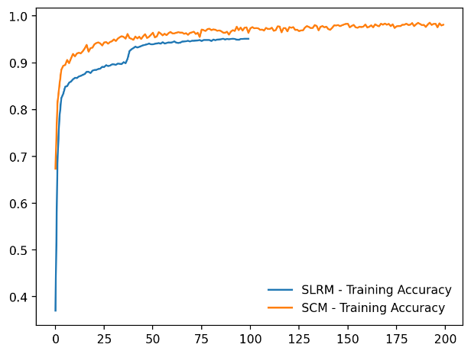
Results & Implementation
Accuracy
Simple Logistic Regression Model: 93.38% test accuracy and a hold-out sample accuracy of 86.10%
SoftMax Classifier Model: 92.68% test accuracy and a hold-out sample accuracy of 91.89%

Slide 9

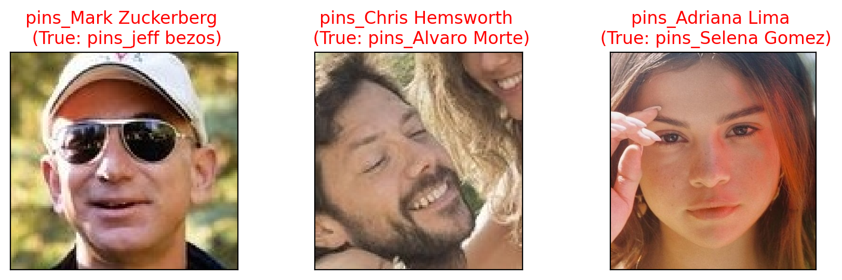
Results & Implementation
False Positives
Out of 259 images, 3 false positives occurred, each influenced by factors like Casted Shadows, Lighting, Individuals Wearing Glasses, or the Presence of Another Person in the Background

Slide 10

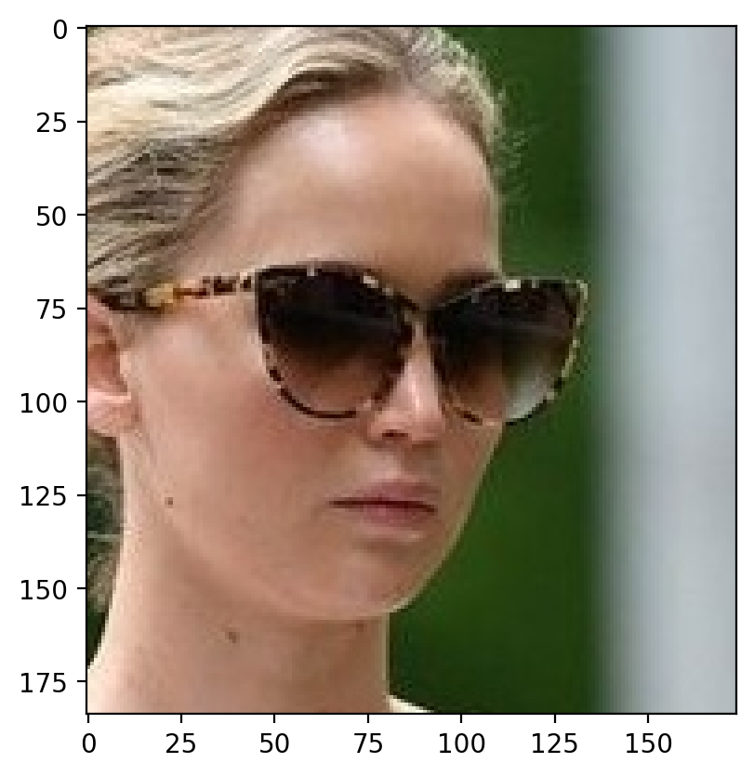
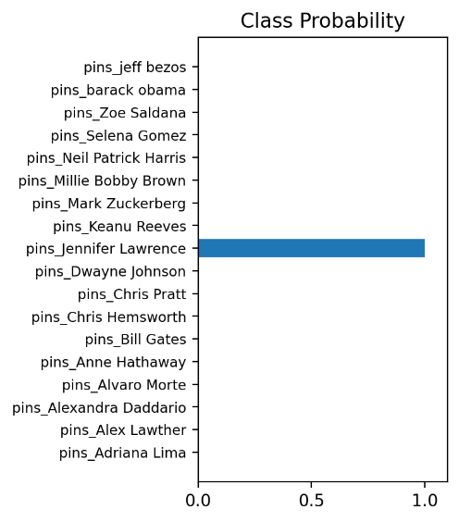
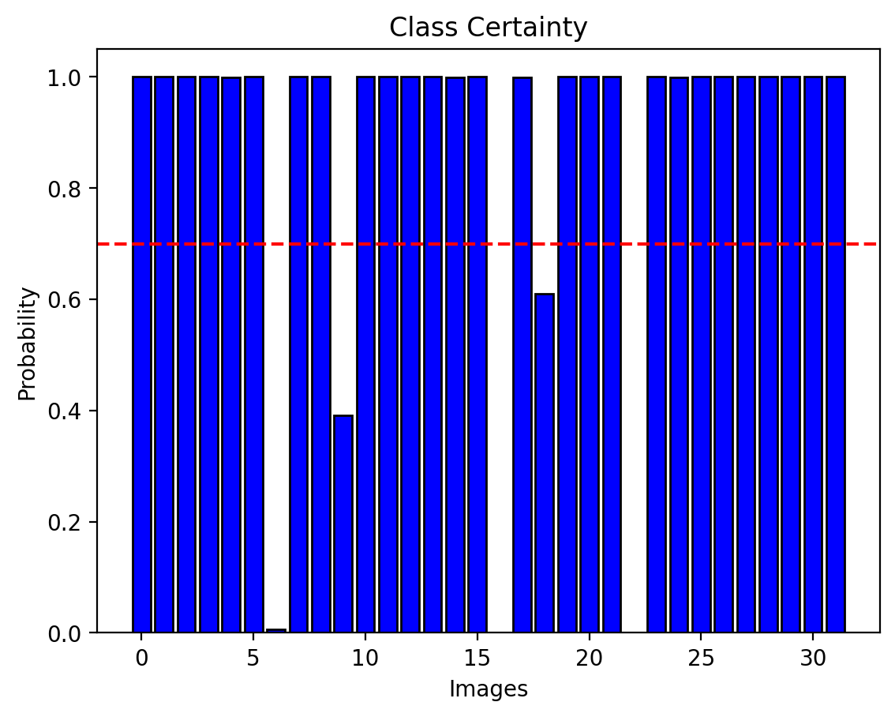
Results & Implementation
Predictions Probability
Very High Probabilities
Class Probability: In a given batch of 32 images, 5 were below the 70% threshold with 3 predicted incorrectly

Slide 11
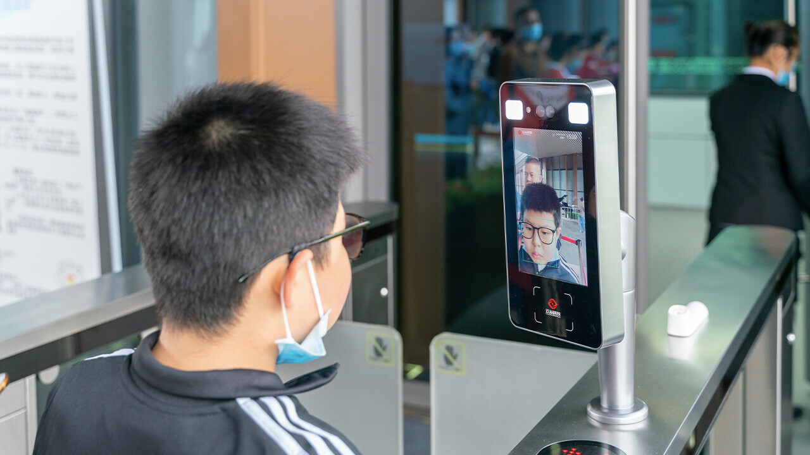

Deployment
Issues & Risks
Schools would need a large dataset to train the model and enhance its accuracy
For any new additional student, schools would have to map a new label to a new image and re-train the model
The model may be impractical at schools that offer short-term programs
As children grow, their facial features also change rapidly, which may not be captured by the model
Privacy/Security Concerns would be an ethical issue faced by schools
Enhances Safety & Security in Educational Institutions
Mood Detection to Understand the Sentiment of Students
Avoids Violent Intrusion by Strangers

Slide 12
THANK YOU!!
Any Questions?

